Slide 1


Day 07
contact@anubhavtrainings.com
ABAP RESTFUL APPLICATION PROGRAMMING

Slide 2

Agenda – Day 07
Understand the persona for Approver
Implementing Approver projection
Annotations for Approver Scenario
Behavior Definition for Approver
Service Binding for Approver Scenario
Fiori App for Approver
Deploy Fiori App to SAP CF
Implementing Level 3 for Booking Supplement
Service Consumption Model
Describing the Concept of Custom Entity
Why we use Custom Entity
Implement Custom Entity
Create Class for Custom Entity
Test Custom Entity
Deploy Fiori App to SAP CF
Fiori App with Launchpad in BTP
What is ABAP Git
Why we use ABAP Git
ABAP Git Integration
Understand How to Use ABAP Git

Slide 3

Understand the Persona for Approver
The business object projection is the basis for a UI service that contains the functionality that is relevant for an approver. Imagine a person, maybe a manager of a travel agency, that approves the data that was entered by the processor. That means, this person sees the travel information and the corresponding booking data. Based on this data, the approver can either accept or reject the travel. For a minimal scope of fields in the travel entity the approver is enabled to edit the values, for example the BookingFee or the Description. The information about bookings is set to read-only for the approver. The approver is not allowed to change the fields of the booking entity.
Approver
Accept
Reject

Slide 4
Approver Scenario
Travel Projection CDS View for Approver BO
Except for the actions, which are different in the processor and the approver projection, the CDS projection views for the processor and the approver BO are identical. Minor changes can be detected in the field label of the field TravelID and TravelStatus. This results from the fact, that the approver does not create new travel entries. It is not necessary for this role to know the number range of the TravelID or the possible values of the TravelStatus. In addition, the approver BO projection has gained a selection field for the TravelStatus to make it easier for the approver to filter for open/accepted/rejected travels.
Actions
The position and the label for the action button must be defined in the CDS projection views. In the case of an approver, the available actions concerning the travel entity set are Accept Travel and Reject Travel. The implementation of these actions is done in the behavior implementation . It is simply the UI appearance that needs to be configured in the projection view. The action buttons for the respective actions are designed to appear on the travel list report page and on the travel object page. That is why the annotations are used in the list item and identification UI annotation. When executing the action on the list report page, a travel instance must be selected to assign an instance for the instance-bound action. On the object page, the instance for which the action shall be executed is clear.
Booking Projection CDS View for Approver BO
The CDS projection views for the processor and the approver BO are almost identical.
Value helps are not necessary for the interpretation of the approver role in this scenario. As the booking entity is a read-only entity in this scenario and selection fields with value helps cannot be defined for a sub entity, value helps cannot be applied and thus are not necessary to be defined for the booking entity.

Slide 5
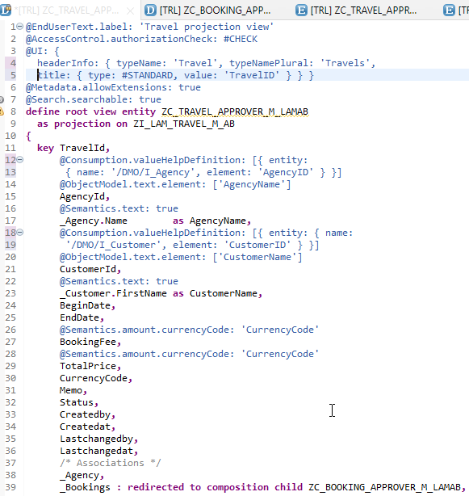
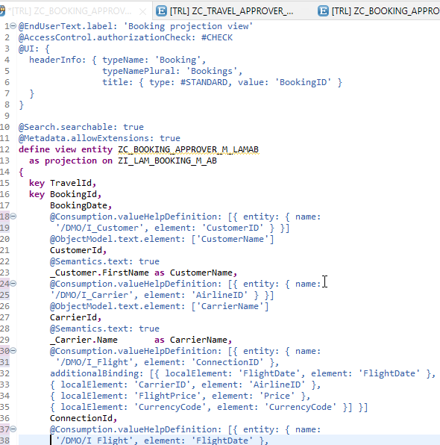
Implementing Approver Projection CDS
ZC_TRAVEL_APPROVER_M_LAMAB
ZC_BOOKING_APPROVER_M_LAMAB

Slide 6
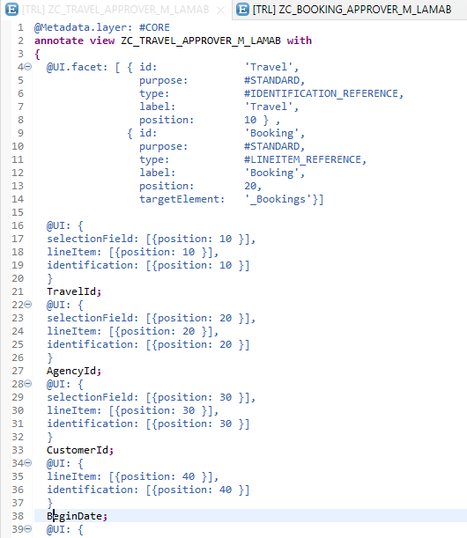
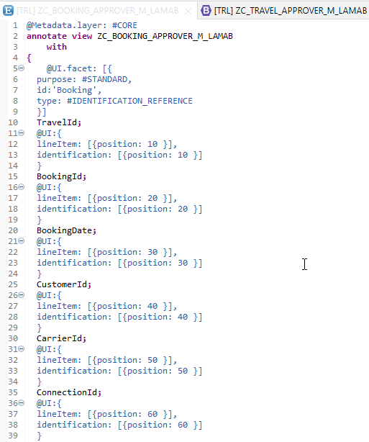
Metadata Extension
Metadata Extension for Travel
Metadata Extension for Booking

Slide 7
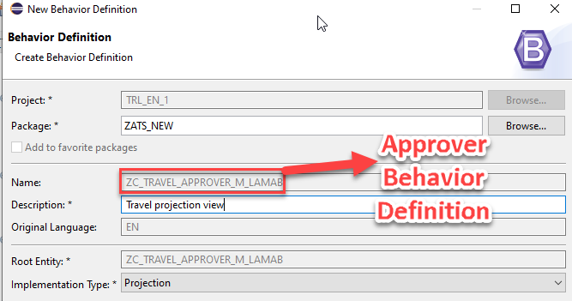
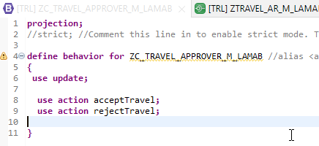
Behavior Definition for Approver
The scope of the UI service for the approver is more limited than for the processor. The approver can only modify the travel entity with accepting or rejecting the travel entries. The values in the corresponding booking entries are the basis for this decision-making.
The behavior for the BO projection is defined in a behavior definition of type projection. The type is defined in the behavior definition header. The projection behavior definition provides the behavior for the projection CDS view. All characteristics and operations that you want to include in the BO projection must be listed explicitly. The keyword for this is use. - Code here

Slide 8
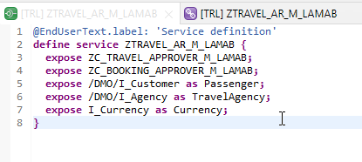
Service Definition
The service definition is a projection of the models and related behavior that you want to expose.
In a service definition, you define the OData service to determine which CDS entities are part of the service. This service is then bound to a protocol and to either a UI technology or an A2X service by a service binding artifact. A service definition can be integrated in various protocols without any reimplementation.
Service definition is used to assign the scope of the OData service. Travel, Booking, Passenger, TravelAgency, Currency CDS views are exposed in the service definition. Optionally, you can assign an alias for the each exposed CDS view
Exercise
Service Definition

Slide 9
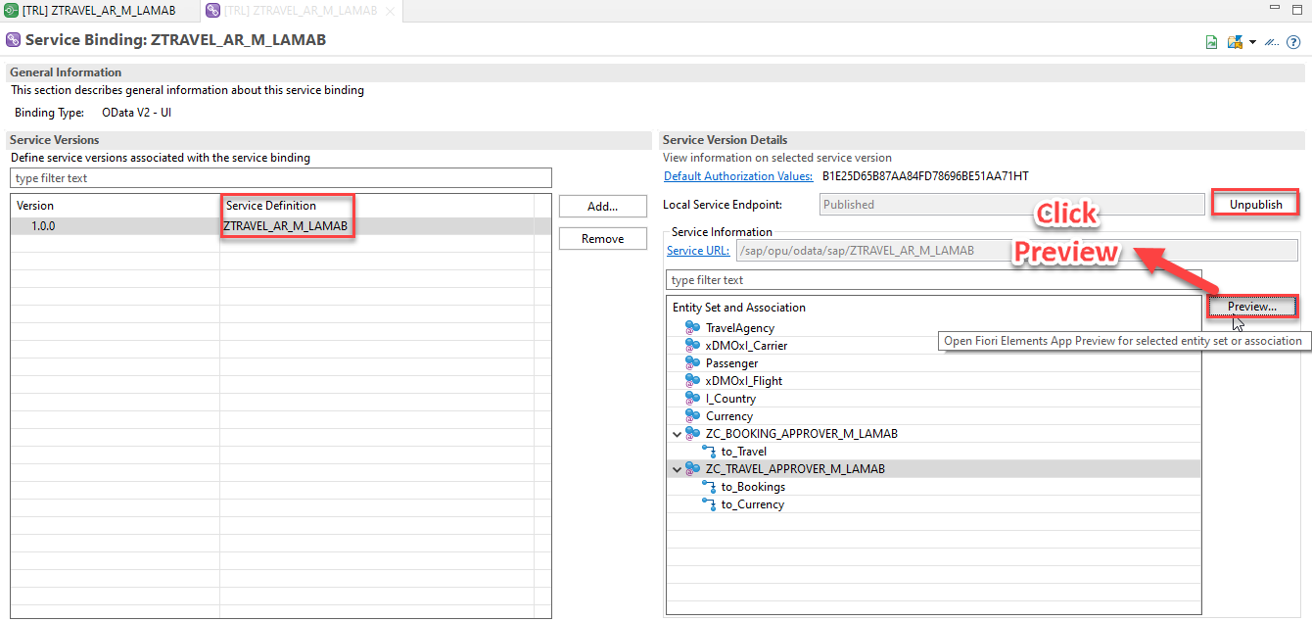
Service Binding
A service binding implements the protocol that is used for the OData service. It uses a service definition that projects the data models and their related behaviors to the service.

Slide 10
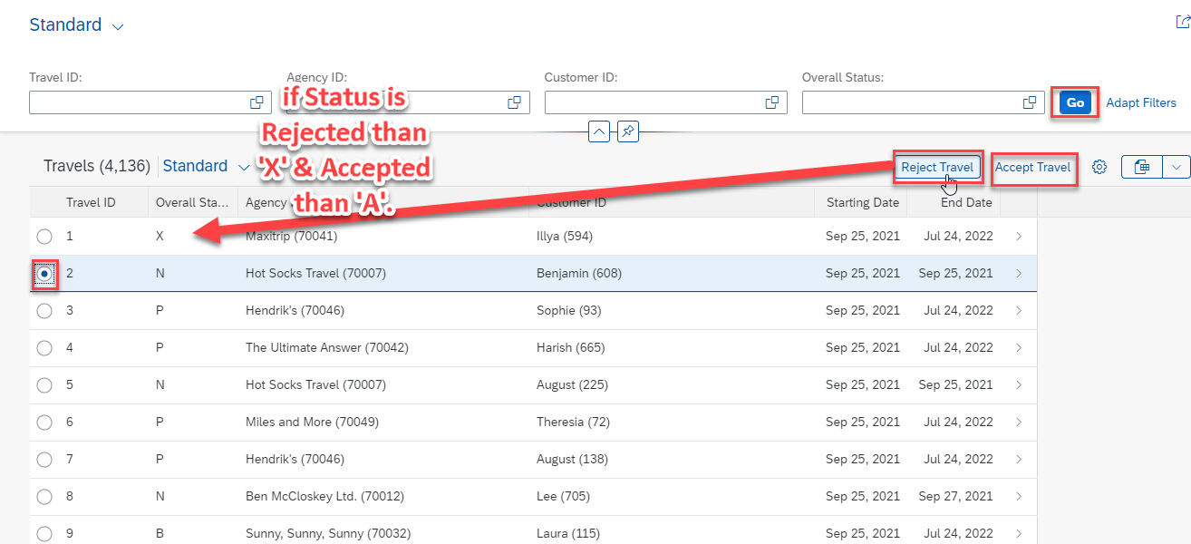
Fiori App Preview

Slide 11
Understand the Persona for Approver
The business object projection is the basis for a UI service that contains the functionality that is relevant for an approver. Imagine a person, maybe a manager of a travel agency, that approves the data that was entered by the processor. That means, this person sees the travel information and the corresponding booking data. Based on this data, the approver can either accept or reject the travel. For a minimal scope of fields in the travel entity the approver is enabled to edit the values, for example the BookingFee or the Description. The information about bookings is set to read-only for the approver. The approver is not allowed to change the fields of the booking entity.
Approver
Accept
Reject

Slide 12
Approver Scenario
Travel Projection CDS View for Approver BO
Except for the actions, which are different in the processor and the approver projection, the CDS projection views for the processor and the approver BO are identical. Minor changes can be detected in the field label of the field TravelID and TravelStatus. This results from the fact, that the approver does not create new travel entries. It is not necessary for this role to know the number range of the TravelID or the possible values of the TravelStatus. In addition, the approver BO projection has gained a selection field for the TravelStatus to make it easier for the approver to filter for open/accepted/rejected travels.
Actions
The position and the label for the action button must be defined in the CDS projection views. In the case of an approver, the available actions concerning the travel entity set are Accept Travel and Reject Travel. The implementation of these actions is done in the behavior implementation . It is simply the UI appearance that needs to be configured in the projection view. The action buttons for the respective actions are designed to appear on the travel list report page and on the travel object page. That is why the annotations are used in the list item and identification UI annotation. When executing the action on the list report page, a travel instance must be selected to assign an instance for the instance-bound action. On the object page, the instance for which the action shall be executed is clear.
Booking Projection CDS View for Approver BO
The CDS projection views for the processor and the approver BO are almost identical.
Value helps are not necessary for the interpretation of the approver role in this scenario. As the booking entity is a read-only entity in this scenario and selection fields with value helps cannot be defined for a sub entity, value helps cannot be applied and thus are not necessary to be defined for the booking entity.

Slide 13
Implementing Approver Projection CDS
ZC_TRAVEL_APPROVER_M_LAMAB
ZC_BOOKING_APPROVER_M_LAMAB

Slide 14
Metadata Extension
Metadata Extension for Travel
Metadata Extension for Booking

Slide 15
Private Cloud
Enterprise Cloud
Public
Cloud
SAP BTP

Slide 16
Internet
Intranet
SAP Business App Studio
S/4HANA Server
On-premise
SAP BTP
Html5 repo
launchpad
SAP SCC
Desti_s4
Desti_ecc
Desti_BW
S/4HANA Server
On-premise
Public AWS
Personal or Office PC
VPN

Slide 17
Steps
Go to BAS tool and create a new dev space of type Fiori to develop Fiori app
Go to service center and create a destination to connect to ABAP system, if we have 5 systems, we will create 5 destinations. If its OP system, we create a single cloud connector system
Create a new List report app View ➔ Find command.. Create Fiori App from template
Once app is generated and dependencies are installed, we can test the app locally in BAS
Add the deployment configuration for Cloud Foundry and Fiori Launchpad properties.
DEPLOYMENT
Terminal ➔ open new terminal and type cf login
In BTP there is a dev space which in turn has html5 repository where our app lives. First we need to packge app and then deploy. We right click on mta.yaml file and choose Build MTA Archieve
We go to package.json file and hover mouse on deploy script and click run.
We can check if the app has reached html5 repository safely. cf html5-list
END USER Access
Goto BTP account and in service marketplace search for launchpad service and start an instance
Open service and create a site
Go to provider, select refresh on html5 repo
Go to content explorer in content manager and choose html5 content provider select and Add my content

Slide 18
Steps
Go to content manager and add a catalog and group
Create a catalog and on right side click search to add our app to the catalog
Create a group and on right side click search to add our app to the catalog
Go to default Everyone Role and also add our app inside
Grant the everyone role to the user’s who want s to access, under sub account ➔ security section

Slide 19
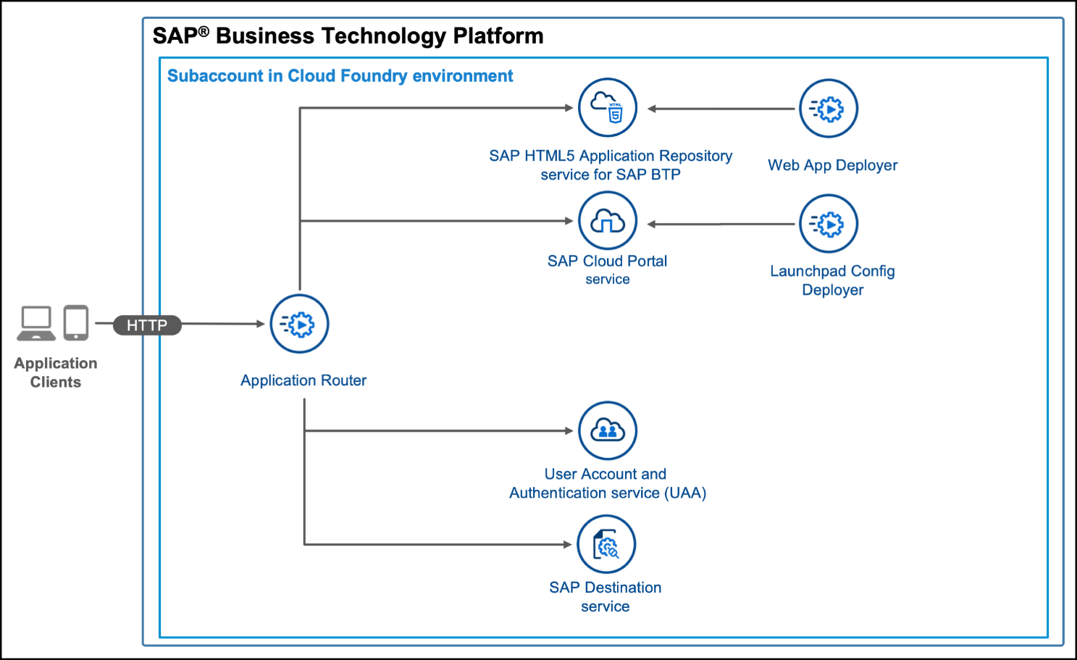
Check the Deployed App
We can use below commands to check deployed apps in BTP
cf html5-list
cf html5-list -di destname -u
https://sap.github.io/cf-html5-apps-repo-cli-plugin/

Slide 20
Behavior Definition for Approver
The scope of the UI service for the approver is more limited than for the processor. The approver can only modify the travel entity with accepting or rejecting the travel entries. The values in the corresponding booking entries are the basis for this decision-making.
The behavior for the BO projection is defined in a behavior definition of type projection. The type is defined in the behavior definition header. The projection behavior definition provides the behavior for the projection CDS view. All characteristics and operations that you want to include in the BO projection must be listed explicitly. The keyword for this is use. - Code here

Slide 21
Service Definition
The service definition is a projection of the models and related behavior that you want to expose.
In a service definition, you define the OData service to determine which CDS entities are part of the service. This service is then bound to a protocol and to either a UI technology or an A2X service by a service binding artifact. A service definition can be integrated in various protocols without any reimplementation.
Service definition is used to assign the scope of the OData service. Travel, Booking, Passenger, TravelAgency, Currency CDS views are exposed in the service definition. Optionally, you can assign an alias for the each exposed CDS view
Exercise
Service Definition

Slide 22
Service Binding
A service binding implements the protocol that is used for the OData service. It uses a service definition that projects the data models and their related behaviors to the service.

Slide 23
Fiori App Preview

Slide 24
Implement Level 3 for Booking Supplement
Now we implement the booking supplement
Travel
(root)
1..N
Booking
RAP Business Object
composition
1..N
Booking Supplement

Slide 25











Slide 26
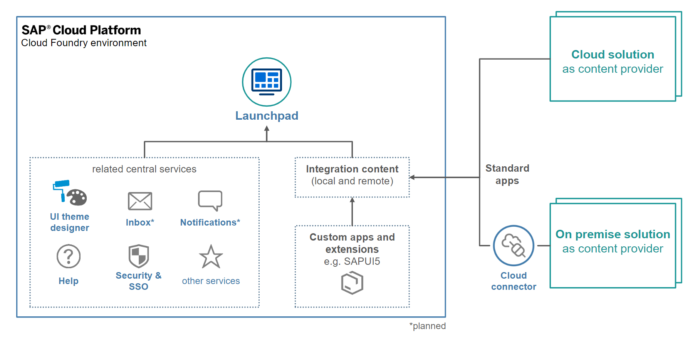
Fiori App with Launchpad and BTP
SAP BTP Platform Launchpad service is a new service on SAP Cloud Platform (Cloud Foundry) which is primarily focused on the enabling customers achieve a central Fiori Launchpad.

Slide 27

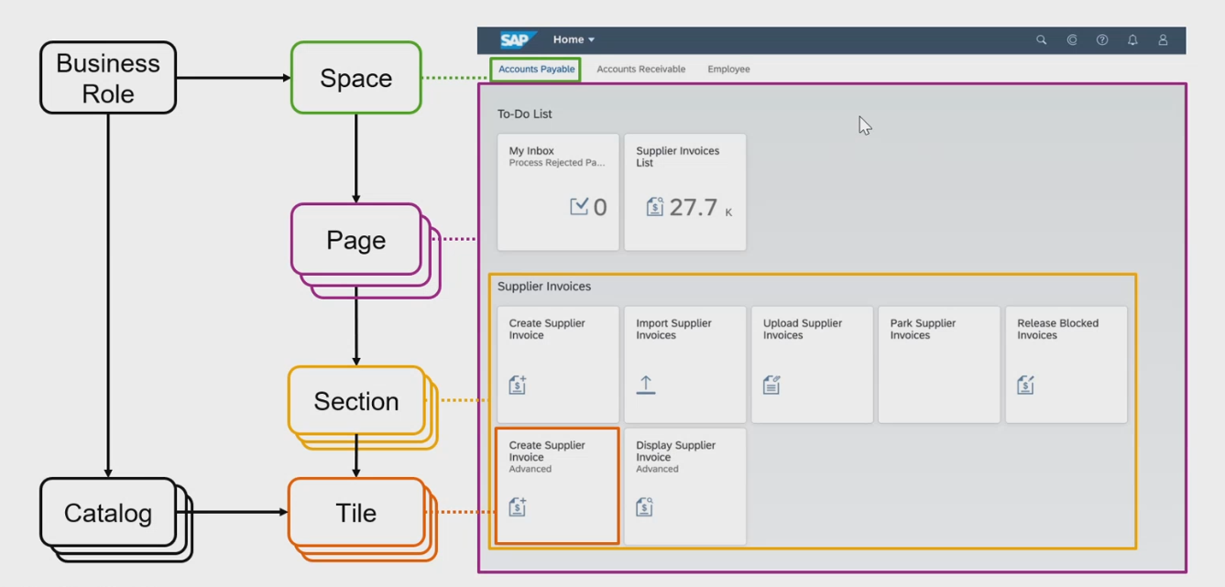
New Launchpad Structure
www.anubhavtrainings.com

Slide 28
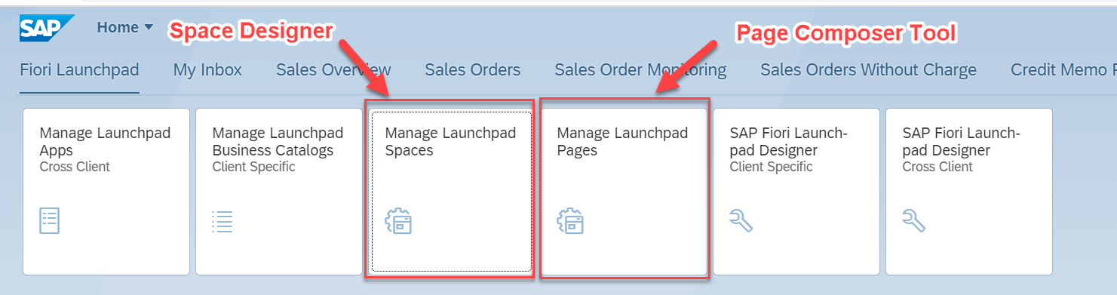
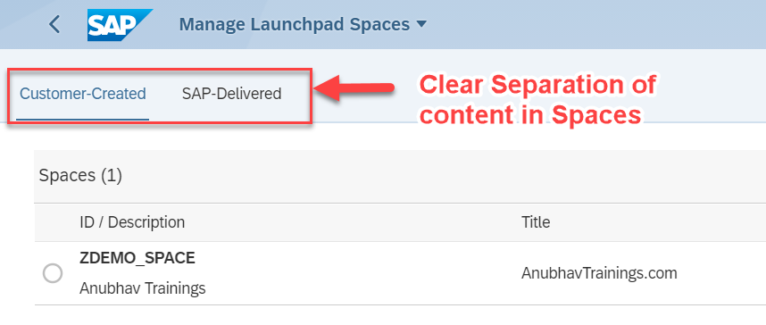
The new Tiles with S/4HANA 2020 – SAP_FLP_ADMIN
www.anubhavtrainings.com

Slide 29
S/4HANA2020- LPD is deprecated
Page composer and Space Designer
SAP_FLP_ADMIN
Fiori Launchpad
Maintenance of groups
SAP Fiori Launchpad
Designer
/n/UI2/FLPD_CONF
Maintenance of Business Catalog
FLP Content Manager
/UI2/FLPCM_CONF
/UI2/FLPCM_CUST
Maintenance of Technical Catalog
Tiles and Target Mappings
Fiori App Manager (earlier named as mass maintenance tool)
/n/UI2/FLPAM
www.anubhavtrainings.com

Slide 30

What is Git ?
Git is a free and open source distributed version control system designed to handle everything from small to very large projects with speed and efficiency.
Git is easy to learn and has a tiny footprint with lightning fast performance. It outclasses SCM tools like Subversion, CVS, Perforce, and ClearCase with features like cheap local branching, convenient staging areas, and multiple workflows.

Slide 31


Git and Git HUB
The git is a distributed repository management system and git hub is a repository which stores our code online.
Install git in our system from here check via command git --help
Mike
(Fiori Developer)
Julie
(Fiori Developer)
VS Code
BAS
git clone <REPO>
project
project
git init
git add . / git add <filename>
git commit –m <change text>
git push
git add . / git add <filename>
git commit –m <change text>
git push
02f35e2
Local git repository
Local git repository
GitHUB
REMOTE Repository
project
ab43f94
project
branch
master
git reset <commitid>

Slide 32
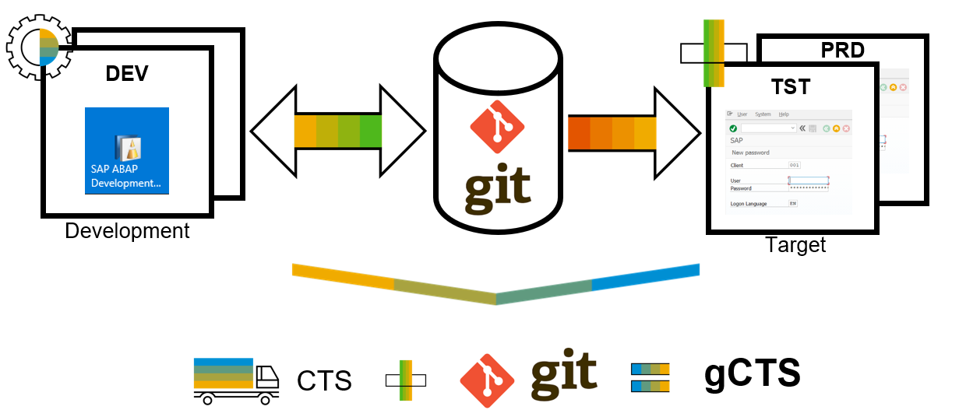
What is ABAP Git ?
abapGit is a tool to import and export code between ABAP systems. If a developer has a developer key to the system, the developer can perform these actions already. abapGit enables the developer to do mass export/changes/imports but not more than already possible to do manually.
Running automated security checks on the abapGit code will by design give a lot of errors, as abapGit will import, overwrite and change ABAP artifacts in the system in ways that might not be intended. Always review all code in remote repositories before importing to the target system, this is possible because abapGit is plain text unlike traditional transport files.
That being said, abapGit is used by mutiple organizations, all abapGit changes are reviewed via pull requests. And all 100+ repository watchers are automatically notified for every change to the code base, so potentially all changes are looked at by more people than tradtional enterprise products.

Slide 33
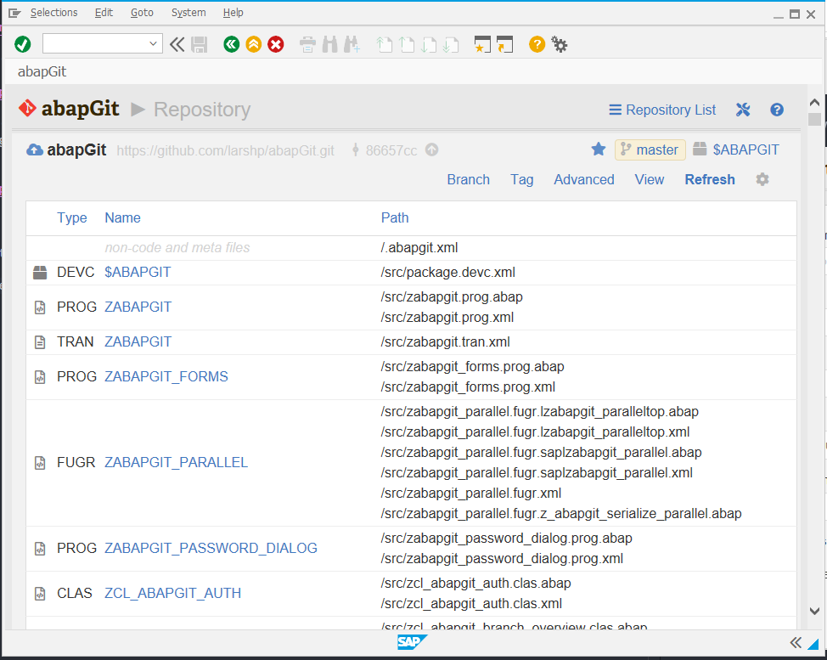
ABAP Git
It is a community effort to support the project, recommend watching the project to get a feeling about issue resolution. Everyone can suggest changes to abapGit via pull requests.

Slide 34
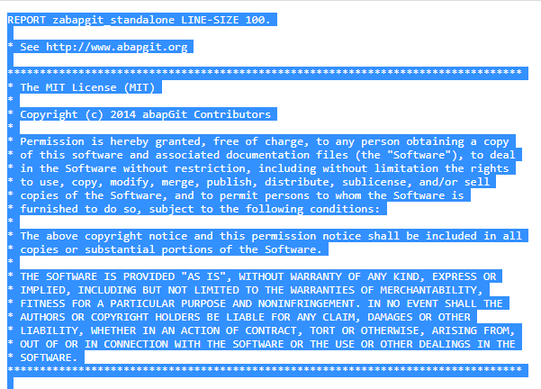
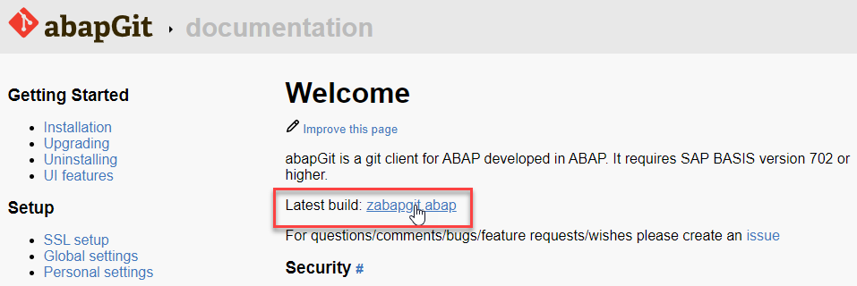
ABAP Git Integration
Step 1. Go to https://docs.abapgit.org/ in browser and click on Latest Build.
Step 2. Copy this Code.

Slide 35
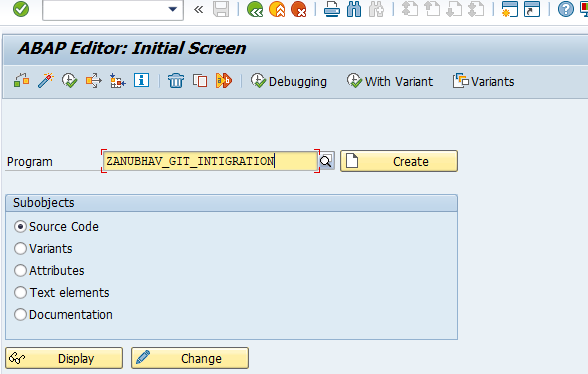
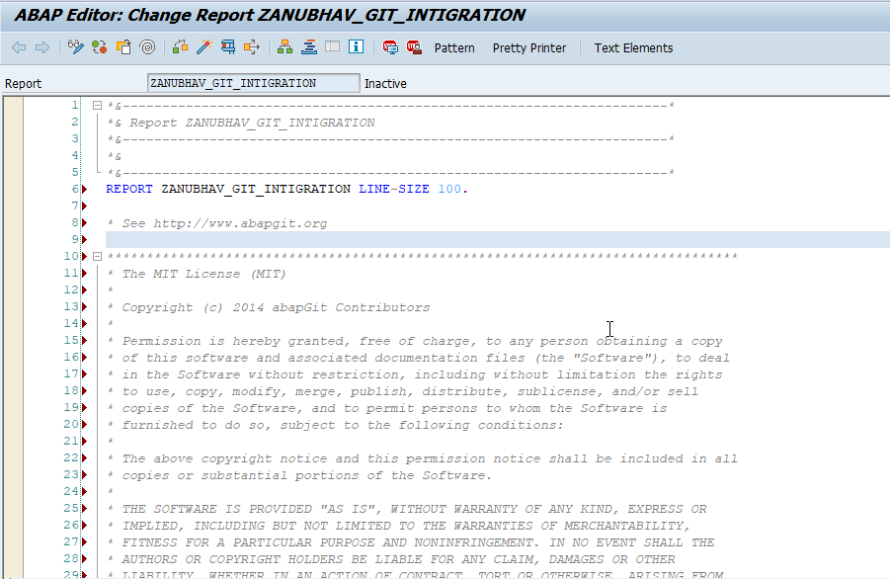
ABAP Git Integration
Step 3. Open SAP Gui Go to T-Code SE38 for Building Report, give any name to report and click on create.
Step 4. Paste the Copied Copy in this report.

Slide 36
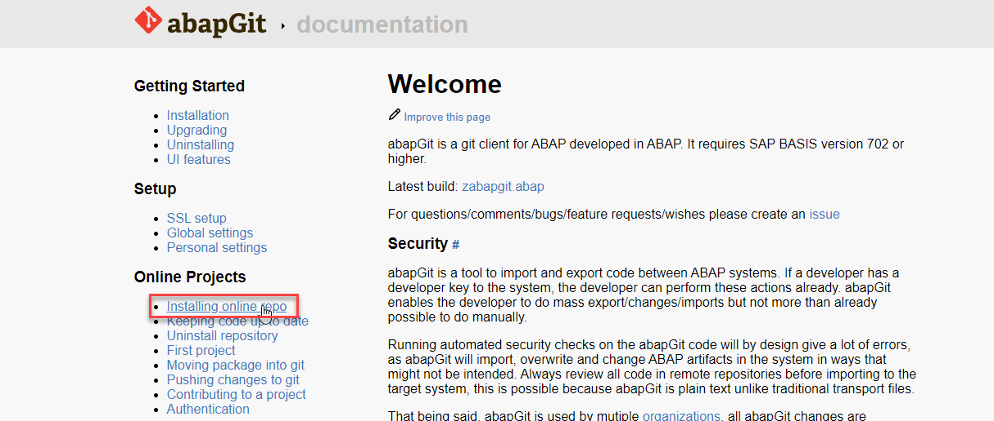
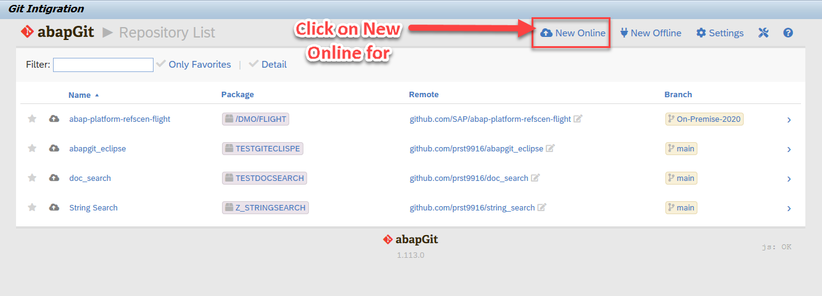
ABAP Git Integration
Step 5. After the Execution, abapGit Screen
Step 6. Go back to Bowser side and click on Installing Online Repo

Slide 37
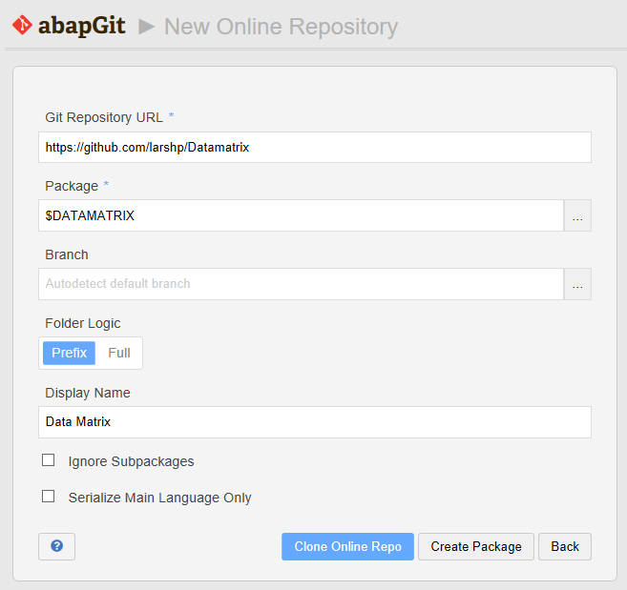
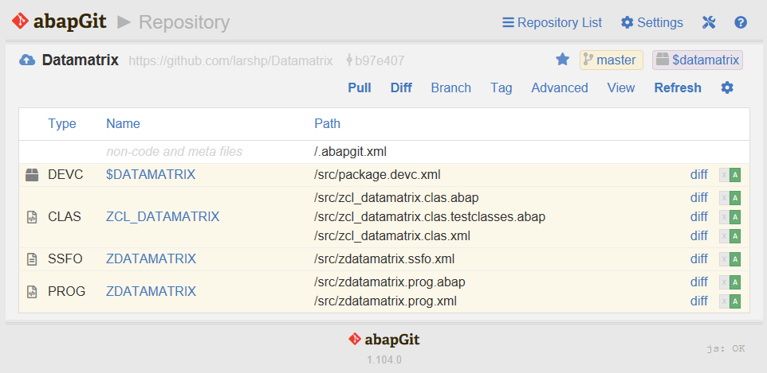
ABAP Git Integration
Step 7. Enter the url for the Github project, eg https://github.com/larshp/Datamatrix along with a package name, eg. $DATAMATRIX. If the package does not exist yet, it will be created automatically when pulling. Alternatively, you can select “Create Package” to create the package manually with your own settings.
Step 8.Select “Clone Online Repo”
Select “Pull” to copy all objects from the Git repository into the SAP system

Slide 38
Introduction – Flexible Service Consumption
For a more flexible service consumption, every transactional business object is projected into a service specific context. In other words, only those elements of the data model and those behavior characteristics and operations that are needed in the relevant business service context are exposed for the service.
By means of projections, you can expose one BO in different business contexts by using different BO subsets. The general business logic is defined in the BO whereas the BO projection adopts a subset of the business logic.
A layering with projections enables robust application programming. You can change or enhance the BO without changing the exposed service as the scope of the service is defined in the projection layer. Enhancing the business object with additional structure or behavior does not have any effect on the resulting service.

Slide 39

End of Day 07
Trainer: Anubhav Oberoy

Slide 40
Trainer: Anubhav Oberoy

Slide 41
THANK YOU
If you cannot do
great things, do small things in a great way.
Anubhav Oberoy
https://www.anubhavtrainings.com

Slide 42


We’re committed to empower you to be
Most Desirable Resource
through powerful training solutions.
We build the workforce of the future.
250+
Corporate Clients
30,000+
Learners Trained
25000+
Learners Placed
FREE WEBINARS
Sign up for free webinars with industry experts every fortnight!
Enroll Now!
Contact us today!
https://anubhavtrainings.com/

Slide 43




More from AnubhavTrainings.com

